Slide 1
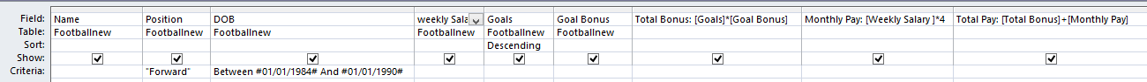
Before you make the report you need to create and save the Query as Goal Bonus. Make a query showing the following Fields: Name, Position, DOB, Weekly Salary, Goals and Goals Bonus Search for all Forward (Positions) Sorts the data into Descending order of Goals Search criteria for DOB Field – Between 01/01/1984 And 01/01/1990 Insert a new field called Total Bonus which is calculated at run-time – You need to multiply the Goals by the Goal Bonus Field ---- Total Bonus: [Goals]*[Goal Bonus] Insert a new field called Monthly Pay which is calculated at run-time - You need to multiply the Weekly Salary Field * 4 Insert a new field called Total Pay which is calculated at run-time - You need to add the Total Bonus and Monthly Pay fields together. Format the three new fields as a currency.
Produce a Report: Fits on a single page wide ---- Has a page orientation of landscape Count the total number of Players (Label – Player Numbers) Calculate the Total Sum, Max, Min and Average (AVG) of the Total Bonus

